Slide 1
Statistics 367-1-4361 Probabilities
Opher Donchin

Slide 2
1.1 Why statistics exists
Scientific questions, measurement, and the limits of data

Slide 3


Why do we need statistics
We want to know about reality
We do experiments
They produce measurements
But we can’t see the reality
Measurement
Experiments
Reality

Slide 4

Statistics: measurements teach us about the world
Given a model
The world is made of geometric blocks
Our measurements tell us something
Measurement
Experiments
Model

Slide 5



But statistics does not provide certainty
Measurements are incomplete
The world is complex
Our models are limited and wrong
Model
Model
Model

Slide 6

From Truth to Data
Francis Bacon
Novum Organum 1620
Facts and observations give us evidence
Pierre-Simon Laplace
Theorie analytique des probabilities 1812
Observations are givens, but they are uncertain
Carl Friedrich Gauss
Theoria motor corporum coelestium 1809
Process givens to improve estimates
In Latin: givens is data

Slide 7
Data gives birth to statistics
Adolphe Quetelet
Sur l’homme 1835
Data on heights implies an “average man”
Francis Galton
Hereditary Genius 1869
Multi-variate data
Variability and co-variance
Karl Pearson
The Grammar of Science 1892
Using data to establish scientific truth
Ronald Fisher
The Design of Experiments 1935
Data is not given; it is generated by design

Slide 8
1.2 What is statistics
Reasoning about reality using data and models

Slide 9
Statistics is about data
Its two main goals
Data
Collecting
Organizing
Analyzing
Interpreting
Exploratory data analysis
Inference
Data
Data
Data

Slide 10

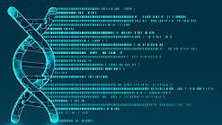
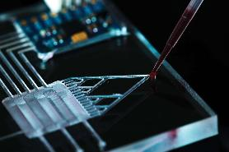
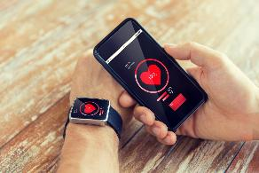
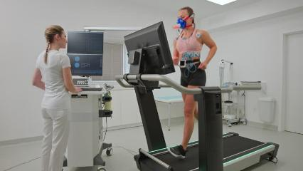
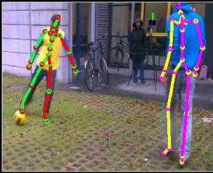
Sources of data in biomedical engineering
Genomic data
Biological data
Physiological data
Clinical data
Models and simulations
New sources:
Large datasets
Wearable technology
Image and video processing

Slide 11
Uses of data in biomedical engineering
Basic science
Clinical testing
Clinical trials
Calibrating models
Product development

Slide 12
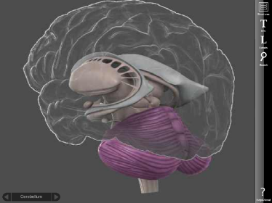
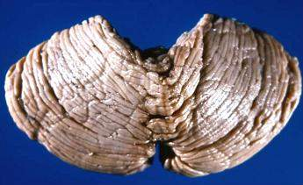
An example of data
Cerebellar volume
http://de.wikibooks.org/wiki/Neuroanatomie:_Kleinhirn
http://brainposts.blogspot.co.il/2011/11/neuropsychology-and-cerebellum-part-i.html

Slide 13
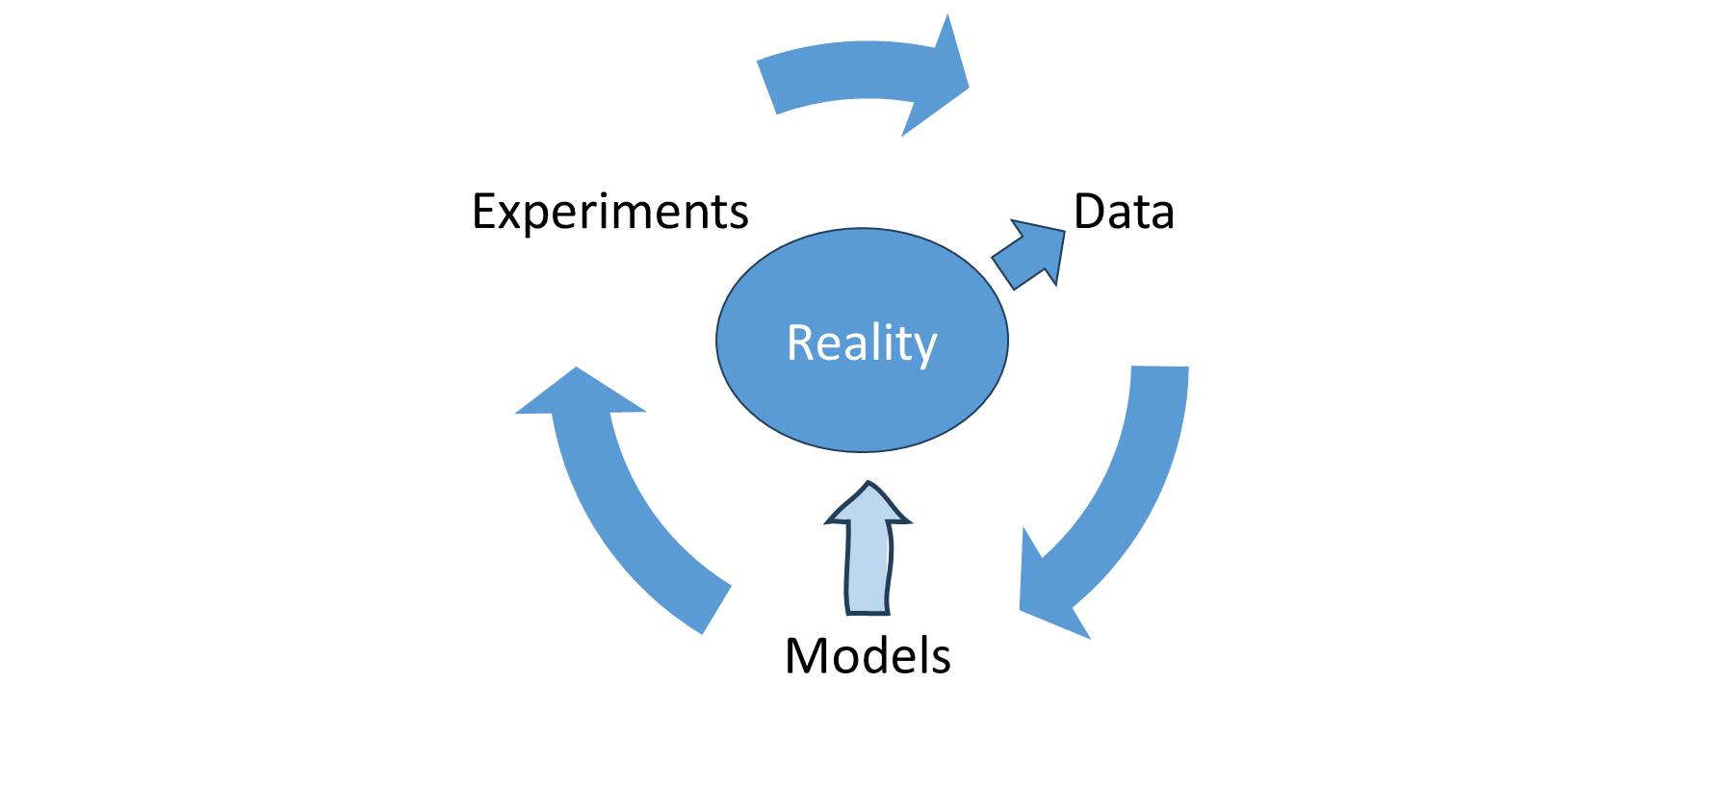
Reality, Data, and Models
Experiments produce data from reality
Data updates models of reality
Models lead to further experiments

Slide 14
Hidden drawing of the intuitive model
Data
Models
Experiments
Reality

Slide 15
Ultimately, it is all grounded in data
Where our ideas meet reality!
But data is:
Complex
Limited
Imperfect
Collected from people
And used to affect people
So what is data?

Slide 16
1.3 What is data
Measurements, observations, and scientific evidence

Slide 17
What is data
An ordered set of ‘observations’ or ‘measurements’
Each observation could be vector valued
Data is finite!

Slide 18
Data is based in measurement
Analyze the brain scans of 5 individuals and extract the size of each cerebellum
Cerebellar volume in liters:
0.16 0.15 0.18 0.21 0.16

Slide 19
Data can include calculations
Unit conversion / normalization
Aggregation (averaging across trials or measurements)
Feature extraction from signals
Derived physical quantitites
Cerebellar volume in liters:
0.16 0.15 0.18 0.21 0.16
Cerebellar volume in fraction of total intracranial volume (TICV):
0.13 0.13 0.12 0.13 0.13

Slide 20
Data must be finite
Analyze brain scans of 60 subjects and extract cerebellar volumes
We can get more data, but it will still be data
Cerebellar volume in fraction TICV for 60 subjects:
0.13 0.13 0.12 0.13 0.13 0.13 0.14 0.10 0.12 0.13
0.11 0.15 0.14 0.14 0.11 0.14 0.14 0.14 0.13 0.14
0.12 0.10 0.11 0.12 0.15 0.14 0.13 0.14 0.14 0.12
0.13 0.15 0.14 0.13 0.13 0.13 0.14 0.13 0.13 0.15
0.12 0.13 0.11 0.10 0.14 0.12 0.15 0.13 0.13 0.13
0.11 0.14 0.14 0.12 0.14 0.13 0.14 0.11 0.12 0.14

Slide 21
Key issues in measurement
What are you measuring?
What is its precision?
Is it valid?
Is it reliable?

Slide 22
Precision
What is a reasonable precision?
How much precision do you need to draw conclusions?
Some things are imprecise by nature
Quality of life
Preference
Fitness

Slide 23
Validity
Does the measure measure what you want?
A written test cannot measure musical ability
Do we have a gold standard?
Can we poll experts?

Slide 24
Reliability
A measure that is precise and stable
The value will stay the same if:
We measure again
Someone else measures
We measure at a different time

Slide 25
1.4 Imperfect data
Noise, bias, and uncertainty in measurement

Slide 26
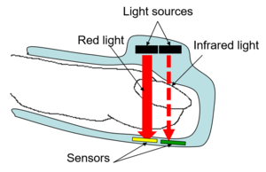
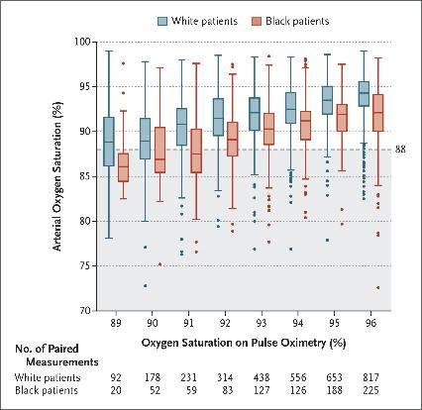
Sampling bias
Data is never perfect
Sampling bias
Pulse oximeters tested on white skin
Poorly calibrated for darker skin
During Covid-19, black patients had:
Lower detection
Delays in treatment
N Engl J Med 2020;383:2477-2478
DOI: 10.1056/NEJMc2029240

Slide 27
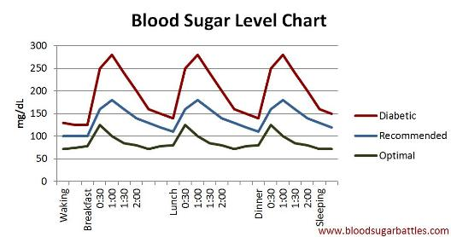
Measurement error
Data is never perfect
Sampling bias
Measurement error
Inaccurate glucose monitors (2018)
Over and underdosing insulin
Diabetes Care 1 August 2018; 41 (8): 1681–1688. https://doi.org/10.2337/dc17-1960

Slide 28

Missing data
Data is never perfect
Sampling bias
Measurement error
Missing data
Increases variance
May introduce bias
N Engl J Med 2020;383:2477-2478
DOI: 10.1056/NEJMc2029240

Slide 29
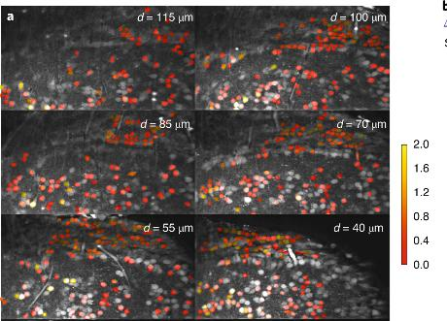
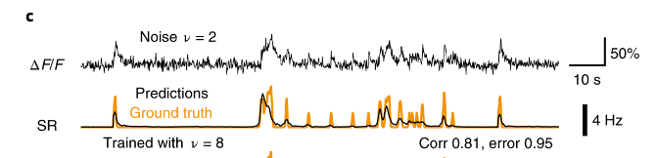
Proxy measures
Data is never perfect
Sampling bias
Measurement error
Missing data
Proxy measures
Intracellular calcium
Used for neural activity
Proxies are:
Nonlinear
Incomplete
Context-dependent
Nat Neurosci 24, 1324–1337 (2021). https://doi.org/10.1038/s41593-021-00895-5

Slide 30
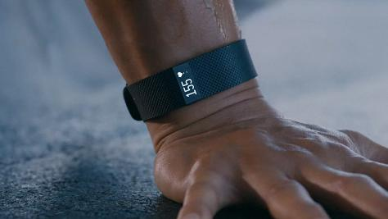
Data Ethics
As data becomes increasingly important
We become increasingly responsible
Privacy
Security
Ethical use
Wearable devices share health information with companies
Can those companies share that information?
The Information Society, 34(1), 49–57. https://doi.org/10.1080/01972243.2017.1391912

Slide 31
Strategies for ethical data use
Informed consent
Explain how and why it is being collected
Allow participants to opt out
Transparency
Who has access and how will it be used
Protect vulnerable populations
Data should not lead to discrimination
Data collection should not lead to secondary harm

Slide 32
1.5 Types of data
How measurements are represented and analyzed

Slide 33
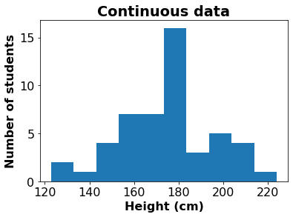
Continuous data
The data are real numbers
Between any two data values there could be another data point
Examples:
Rate, size, amplitude, time

Slide 34
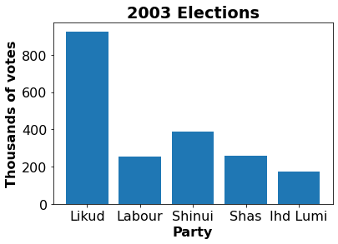
Categorical data
Values can’t really be compared or put on a scale
Examples:
Gender (male / female)
Race
Personality type
Color

Slide 35
Ordinal data
Something between continuous and categorical
Data can be ordered but are not real numbers
Data maps onto the integers
Examples:
Child, teen, adult
Strongly approve, approve, don’t care, disapprove, strongly disapprove
Undergraduate student, graduate student, lecturer, professor

Slide 36


Combining different data types
A datum could have multiple parts:
From a database of brain scans:
Gender
Categorical
Handedness
Categorical
Age
Ordinal / continuous
Education
Ordinal
Total intracranial volume
Continuous (ordinal)
Normalized brain volume
Continuous
Taken together, all of these would be one data point
Female
Right handed
74 years
High school
1344 mm³
0.743
Male
Right handed
39 years
College
1636
0.739

Slide 37
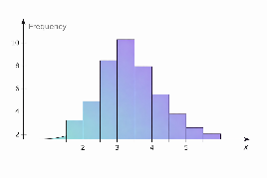
Moving from data to models
Since data is
Complex
Imperfect
We need a framework
Our data give us information
But leave us uncertain
Probability is the logic of uncertainty

Slide 38
1.6 Probability and uncertainty
Quantifying uncertainty about unknown quantities

Slide 39
The basic discovery loop
Start with data
Make model of data
Combine data with model
To reach conclusions
Evaluate model
Update
Repeat

Slide 40
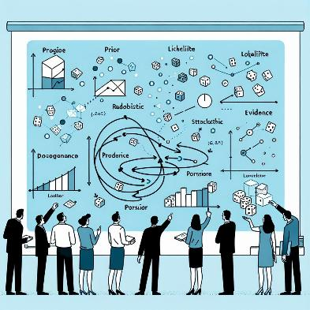
Uncertainty is inevitable
Data is imperfect
Our model will treat it as stochastic
So:
We need to discuss probability

Slide 41
Two kinds of uncertainty
Both described with probability
Aleatory uncertainty
Randomness in the system itself
Epistemic uncertainty
Uncertainty from incomplete knowledge

Slide 42
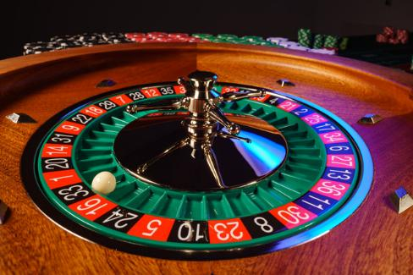
Aleatory uncertainty
Roulette
The wheel is fixed and known
Probability described by long term frequencies
Outcome determined by physical randomness

Slide 43
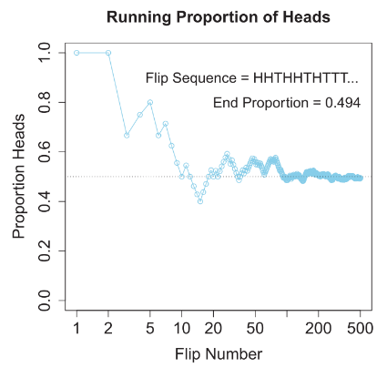
What does P(A) mean?
Frequentist interpretation (Out of the head)
If we repeat the experiment N times, the number of times A occurs (#A) converges to:

Slide 44
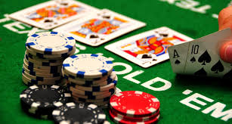
Epistemic uncertainty
Poker (specifically Texas Holdem)
Shared and private information
Probability describes uncertainty given each players information
More data reduces uncertainty
But doesn’t eliminate it

Slide 45
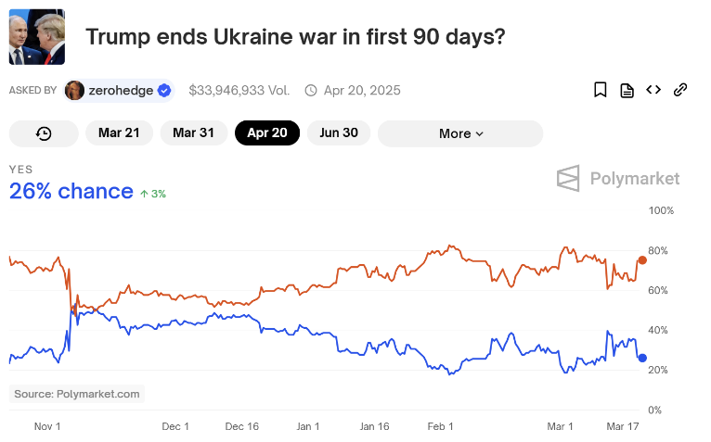
Example: political futures
https://polymarket.com/event/trump-wins-ends-ukraine-war-in-90-days?tid=1742336531501

Slide 46

Varieties of epistemic uncertainty
Subjective probability
Market-implied probability
Risk-neutral probability

Slide 47

Two distinct ideas about probability
Probability describes random processes in the world
Aleatory uncertainty
Irreducible
Probability describes gaps in our knowledge
Epistemic uncertainty
Reduced with increased information
Two basic approaches to statistics based on these:
Frequentist statistics / Aleatory uncertainty
Bayseian statistics / Epistemic uncertainty
Aleatory
Epistemic

Slide 48
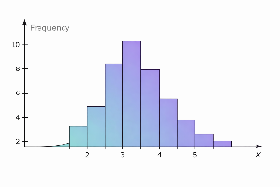
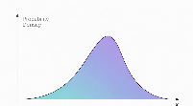
Probability distributions
Probability in our models
Reflects uncertainty about reality
A probability distribution
Represents possible values for a variable
More likely values get more probability

Slide 49
1.7 Probability distributions
Parameterized probability distributions express multiple possibilities

Slide 50
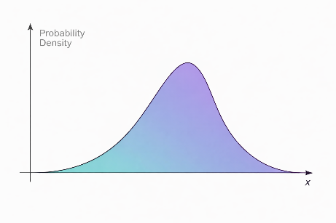
Random variables
A discrete random variable may have different specific values
Probability associated with each value
A continuous random variable can have any value in a range
Probability associated with a range of values
x | p(x)
0 | 0.5
1 | 0.2
2 | 0.15
3 | 0.1
4 | 0.05

Slide 51
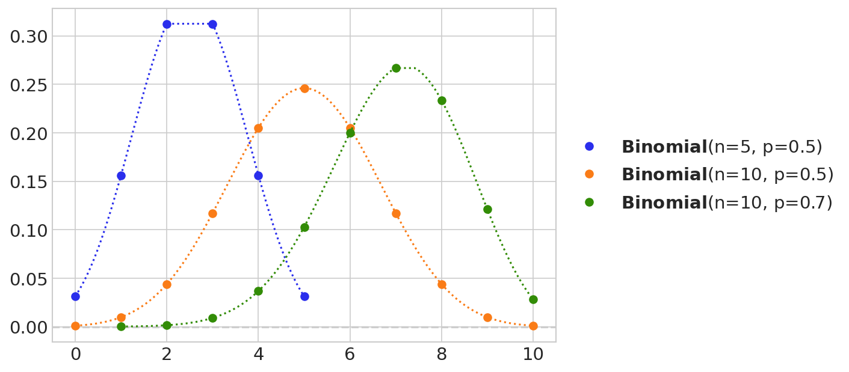
Discrete probability distributions
The binomial distribution has 2 parameters

Slide 52
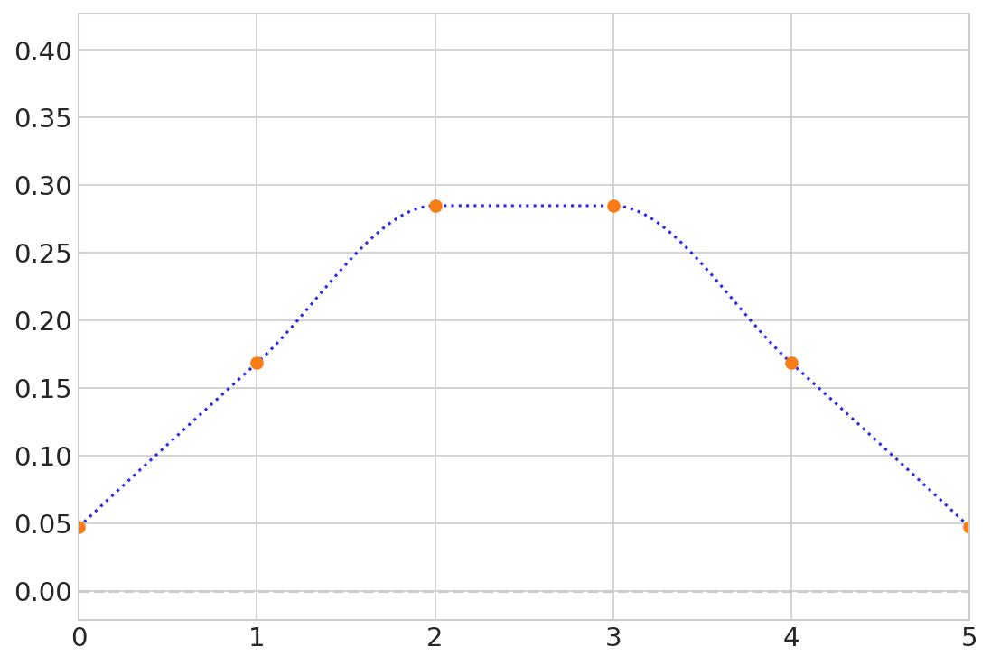

Exploring a distribution
Preliz software package has interactive plots so you can see what parameters do
pz.BetaBinomial(alpha=10, beta=10, n=5).plot_interactive(pointinterval=False)

Slide 53
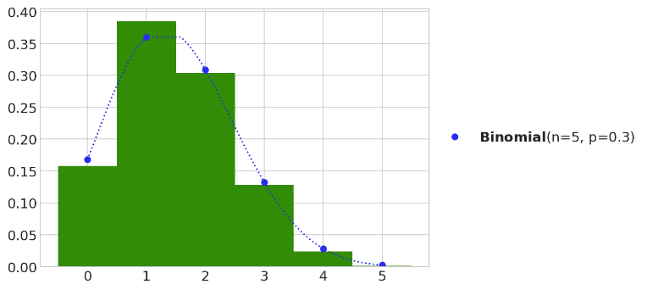
Generating samples from a distribution
plt.hist(pz.Binomial(p=0.3, n=5).rvs(1000),
bins=[0, 1, 2, 3, 4, 5, 6], density=True, align="left", color="C2")
pz.Binomial(p=0.3, n=5).plot_pdf();

Slide 54
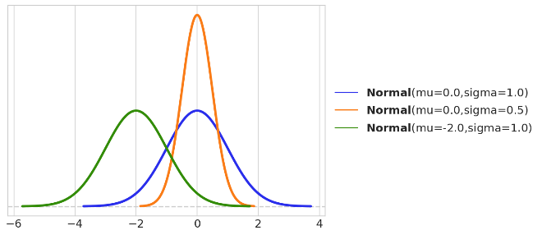

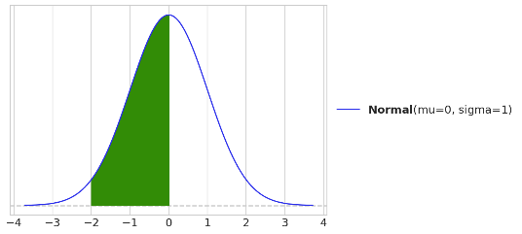

Continuous probability distributions

Slide 55

Continuous random variables
dist = pz.Normal(0, 1)
ax = dist.plot_pdf()
x_s = np.linspace(-2, 0)
ax.fill_between(x_s, dist.pdf(x_s), color="C2")
dist.cdf(0) - dist.cdf(-2)

Slide 56
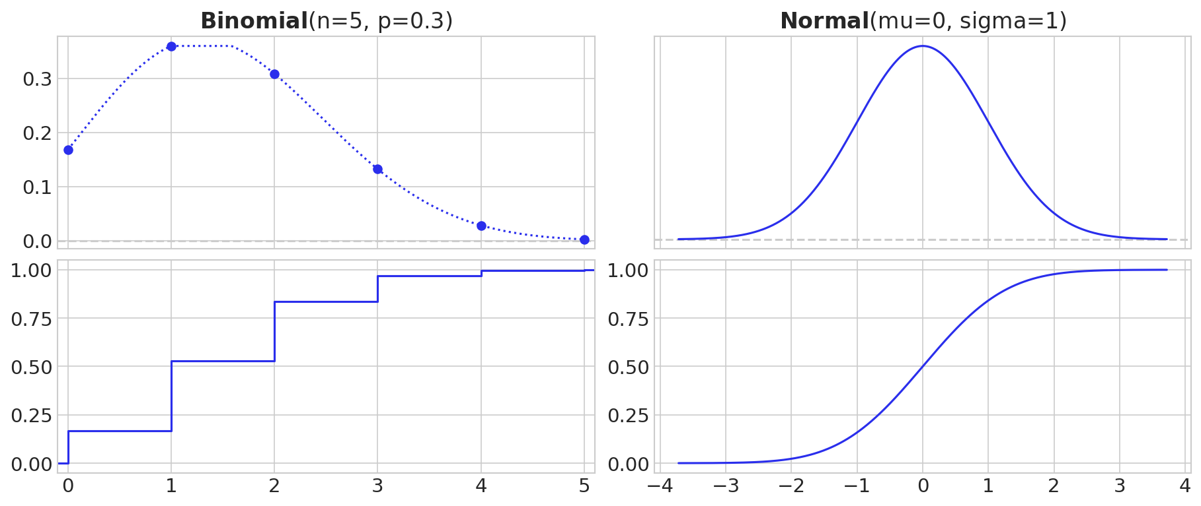
Cumulative distribution functions
_, ax = plt.subplots(2, 2, figsize=(12, 5), sharex="col")
pz.Binomial(p=0.3, n=5).plot_pdf(ax=ax[0, 0], legend="title")
pz.Binomial(p=0.3, n=5).plot_cdf(ax=ax[1, 0], legend=None)
pz.Normal(0, 1).plot_pdf(ax=ax[0, 1], legend="title")
pz.Normal(0, 1).plot_cdf(ax=ax[1, 1], legend=None)

Slide 57
1.8 Parameters and describing distributions
Summarizing the world

Slide 58
Describing the distribution with one number
We want to use a single number to describe the distribution
We can choose it
Where is the ‘middle’ of the data?

Slide 59
The central tendency
Where is the ‘middle’ of the distribution?
Three common measures
Median
Mode
Mean
There are others

Slide 60
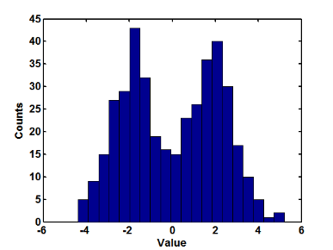
More than one mode
It is possible to have more than one mode
This often means that the distribution combines two different sources
Modes

Slide 61
Unimodal and multimodal distributions
The mode is the point with the largest probability
We usually take multi-modal data to be selected from different unimodal distributions
So we will usually only deal with unimodal data

Slide 62
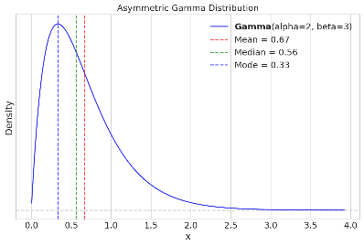
Measures of central tendency
Notice the difference between the mean, the median, and the mode
Which is better?

Slide 63
Representing a distribution with two numbers
The first number: where is the center?
The second number: how close to the center are we?
The dispersion
The center

Slide 64
Representing the distribution with two numbers
Center and spread
Again, we have different measures
The standard deviation is the most commonly used
The variance:
The standard deviation:
The absolute deviation:
The inter-quartile interval: The difference between 0.75 and 0.25 of the distribution

Slide 65
Representing more details about the distribution
What should we use?
Skewness
How symmetric is the data?
Kurtosis
How sharp is the peak?

Slide 66
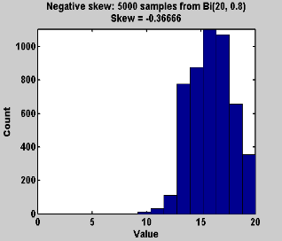
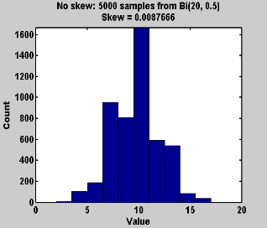
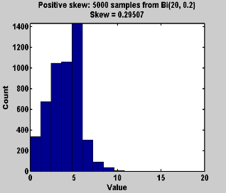
Measure of assymetry: Skewness
For the normal distribution, we only need mean and variance
For any other distribution, it will vary in either skewness or kurtosis
Skewness measures the symmetry of the distribution

Slide 67
Sharpness of peak: Kurtosis
Kurtosis measures the size of the tails
This also captures the pointiness of the peak

Slide 68
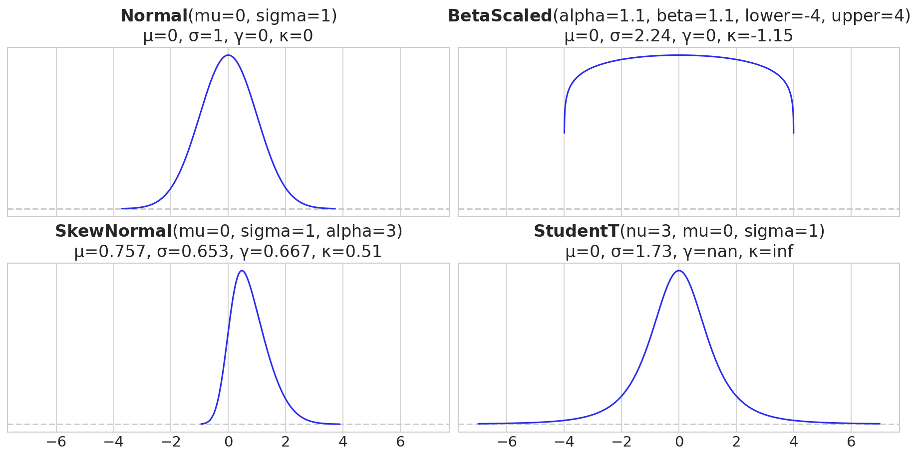
Different distributions with different
Mean
Standard Deviation
Skewness
Kutosis

Slide 69
1.9 About this course
How we will learn statistical modeling

Slide 70
Course goals
Understand what data is
Create models that may explain data
Draw conclusions about the models from the data
Test hypotheses by comparing models

Slide 71
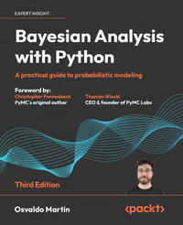
Bayesian Analysis with Python
3rd edition!!
GitHub
Publisher’s website
Full text available
the library
Easy to read!
Some of what is covered in the course is not in the book

Slide 72
Grading
In class activity
Questions during lecture (WooClap)
5% of the grade
Exercises
15% of the grade
3 exercises. Each worth 3%
WooClap on the exercise in the tutorial following submission
Worth 2%
Midterm quiz
10% of the grade. Can only improve grade!
On computers during recitation section on 5.5
Practice for exam
Exam
70% of the grade
On computers on campus
Closed book (we will prepare a formula sheet)
2 hours
Students who do not pass the exam will not pass the course

Slide 73
Resources
Lectures
Slides
Notebooks
Handouts
WooClaps
Tutorials
Slides
Notebooks
Homeworks
Questions
After submission:
Solution notebook (after submission)
WooClaps
Exam
Formula sheet
Practice questions

